Slide 1
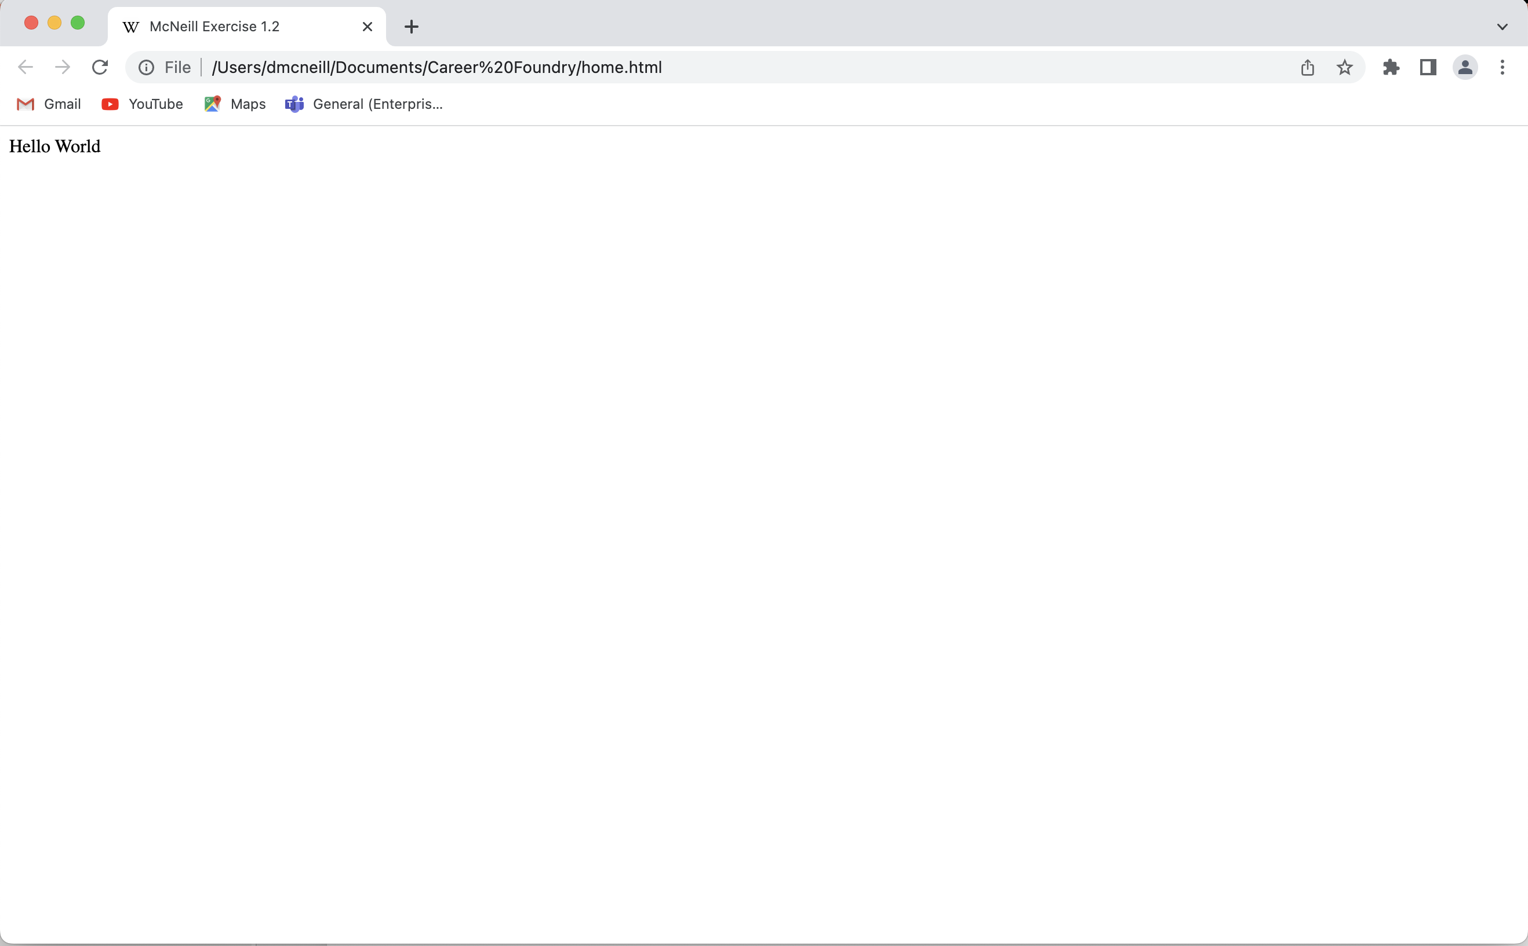
Screen shot of my first HMTL page, complete with the Wikipedia favicon.

